Slide 1
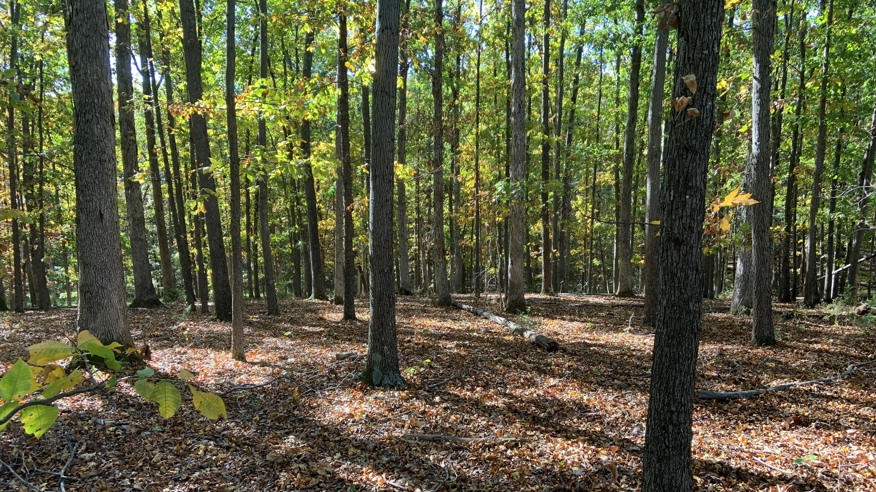

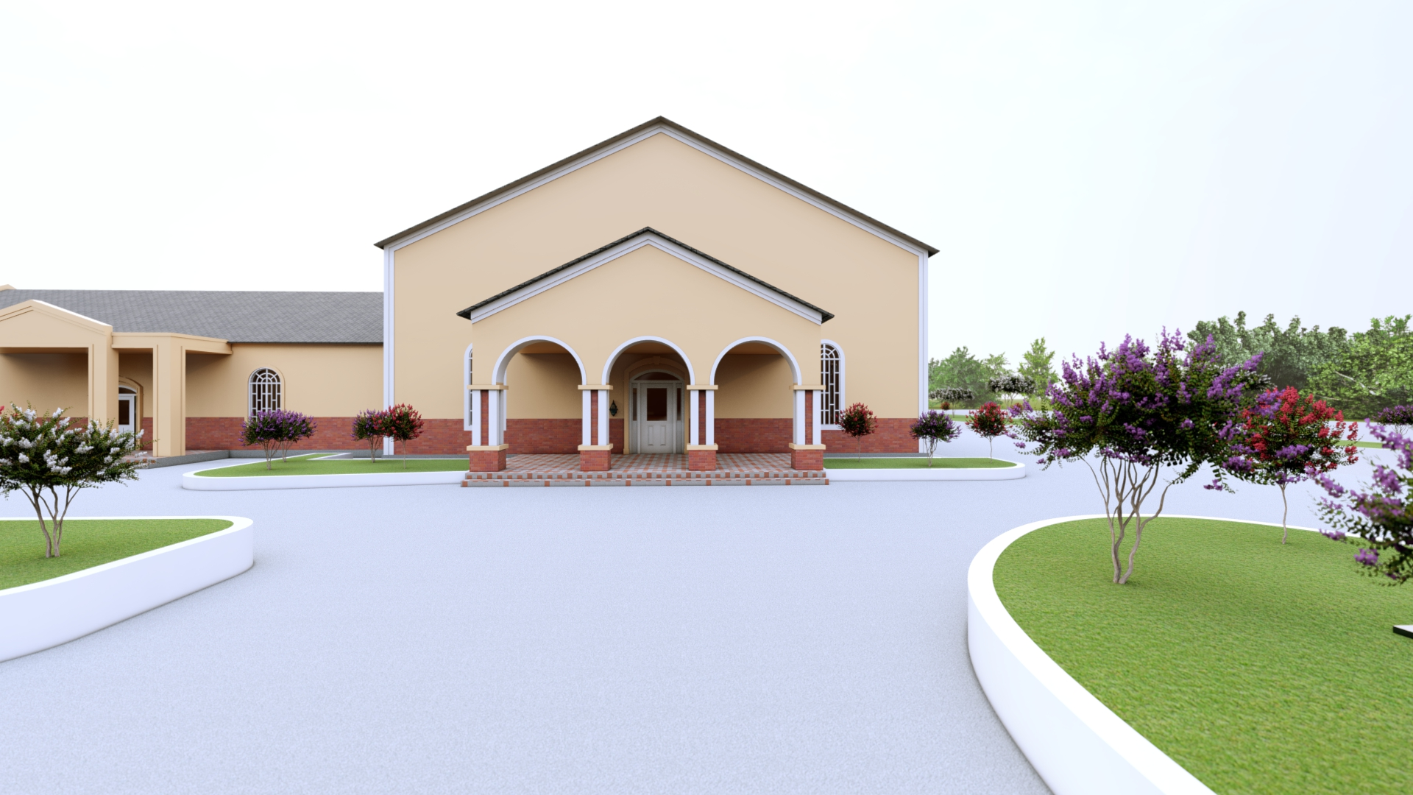
The Road to our new chapel
Building a New Home for Our Parish
Notes:
For more than five years, we have prayed, searched, and discerned. Tonight/Today I would like to briefly share where we began, where we stand now, why this project is necessary, and what lies ahead.

Slide 2

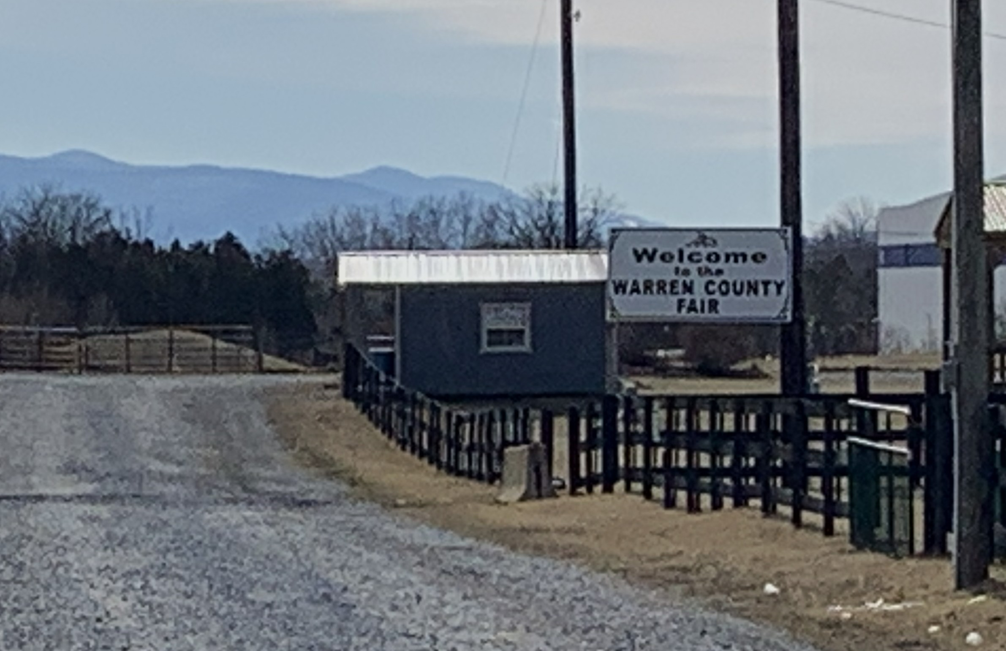
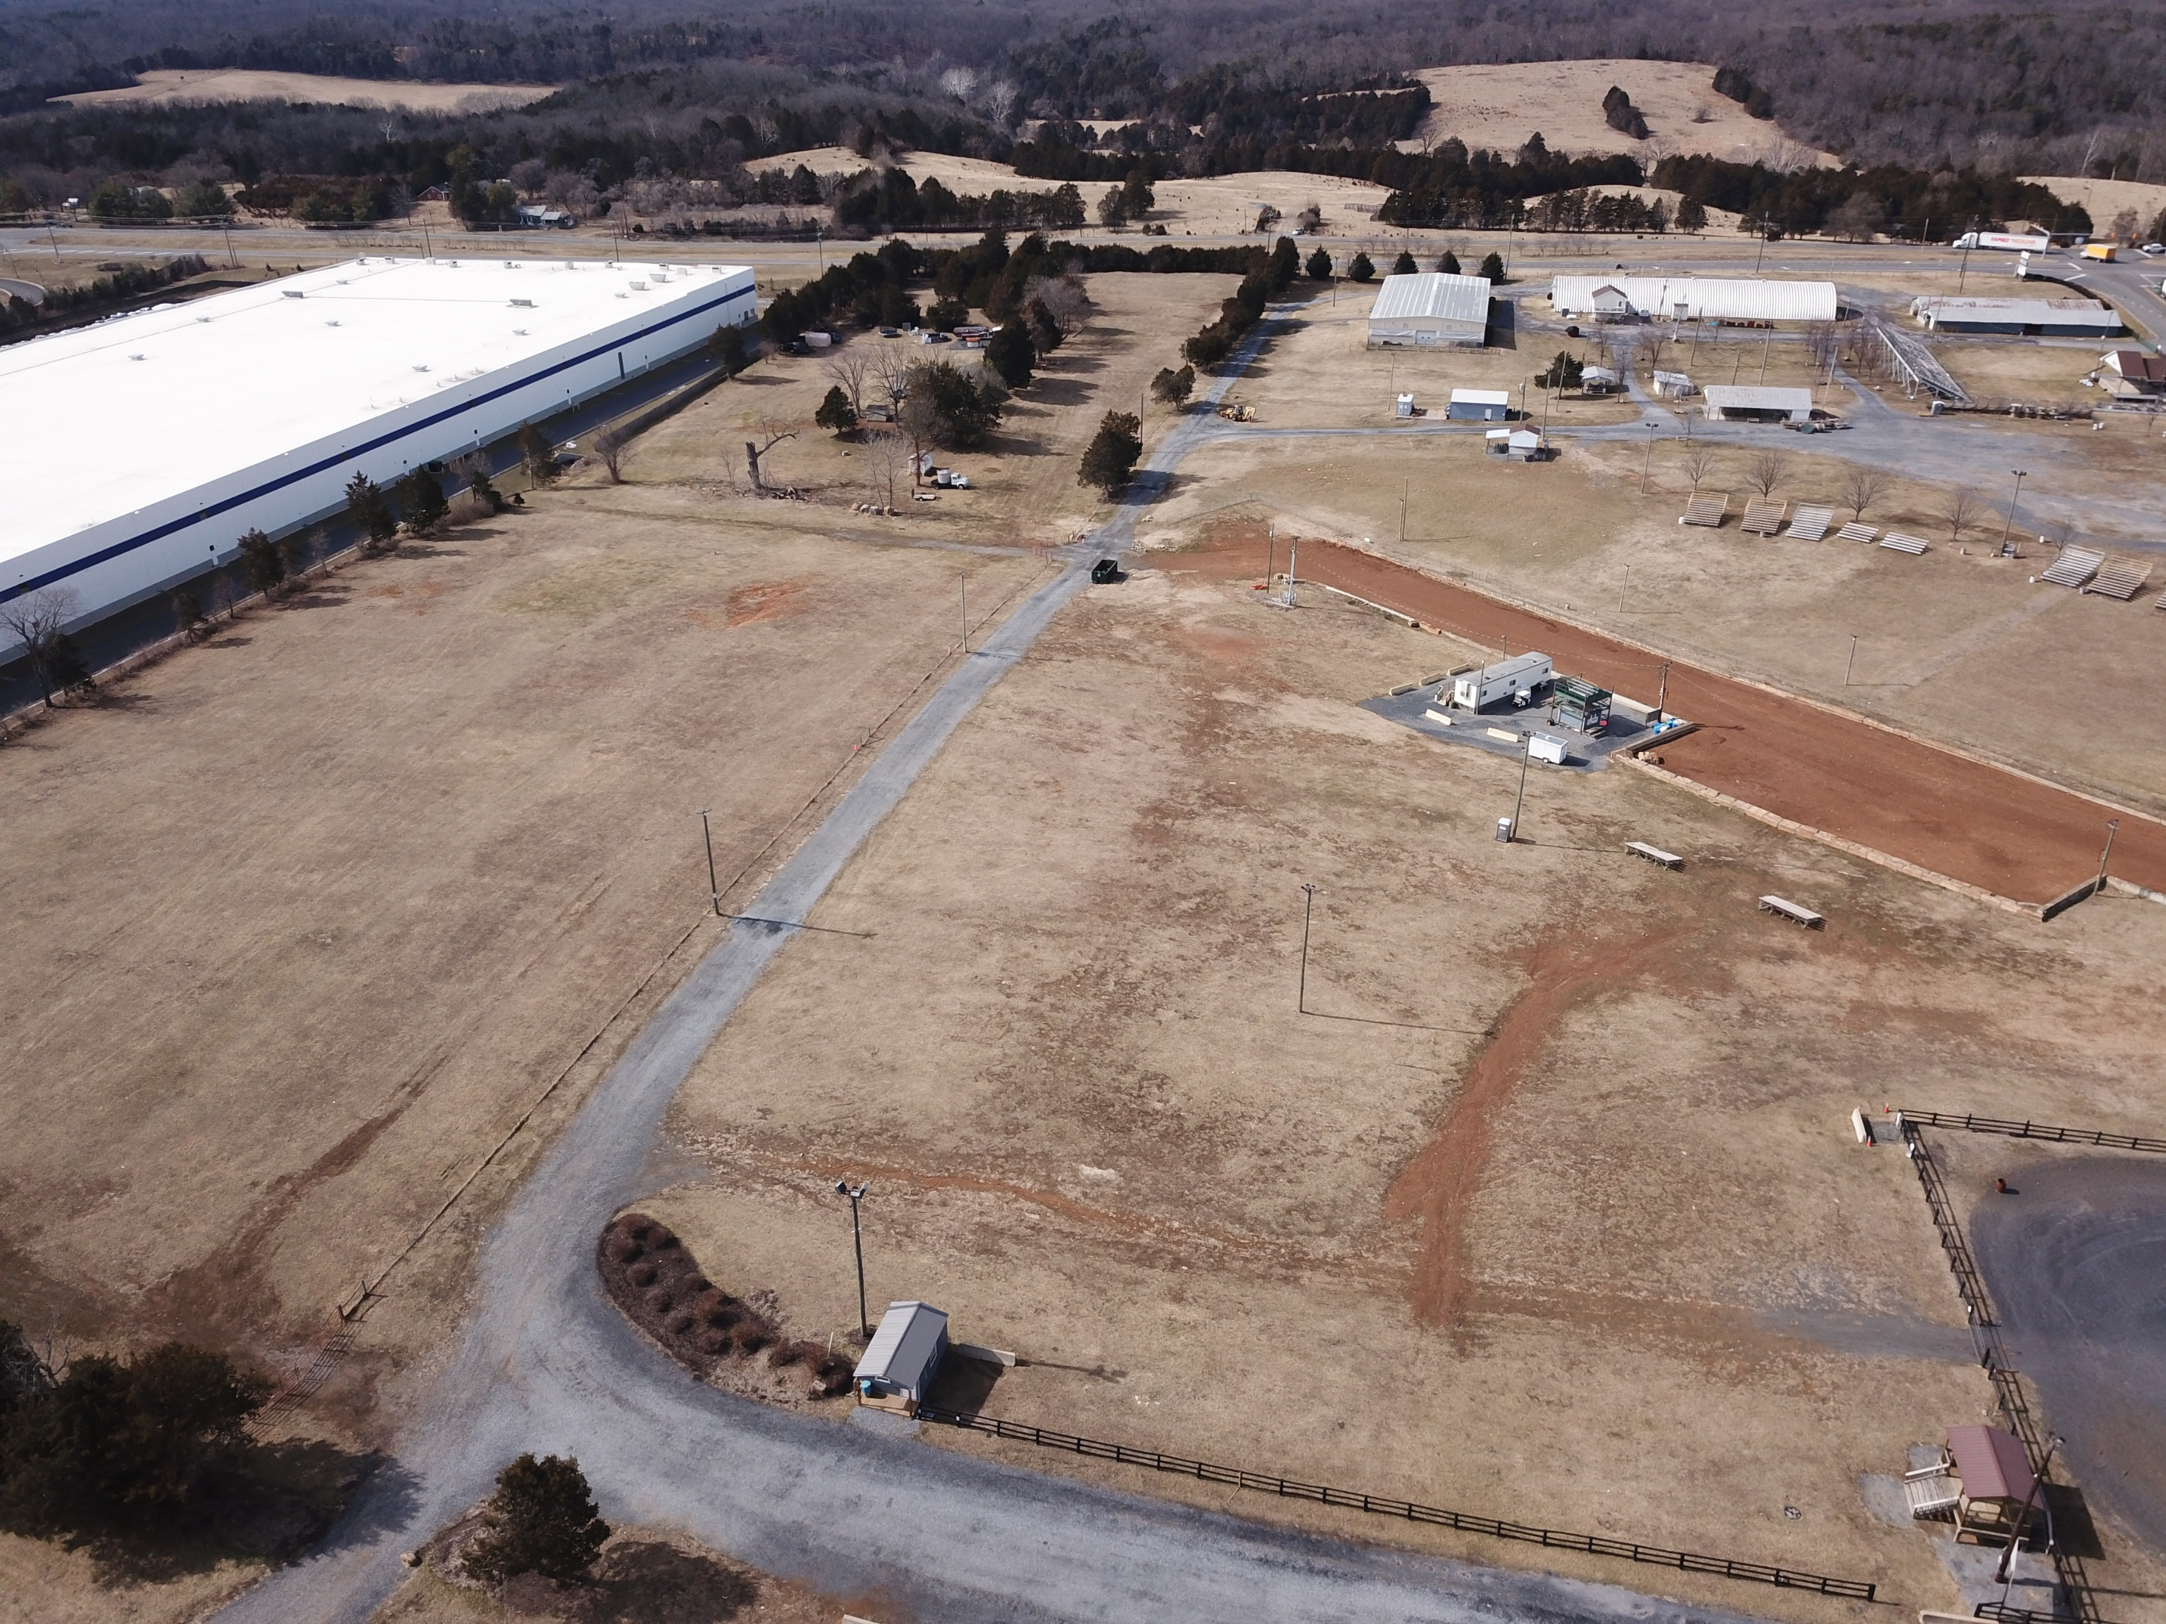
Where We Started
The Gift of covid
Warren County
Fairground
Notes:
Where we Started:
Get a Drone picture of park
The chapel began in 2020 during the Covid scare. Unlike many diocesan churches that were limited by government-mandated closures, the SSPX priests at St. Thomas Acquinas Seminary arranged to provide access to the Mass and the sacraments for the faithful, by holding services outside at the fairgrounds. Fr. Haynos – Personal story of people coming home – Divine Providence…

Slide 3
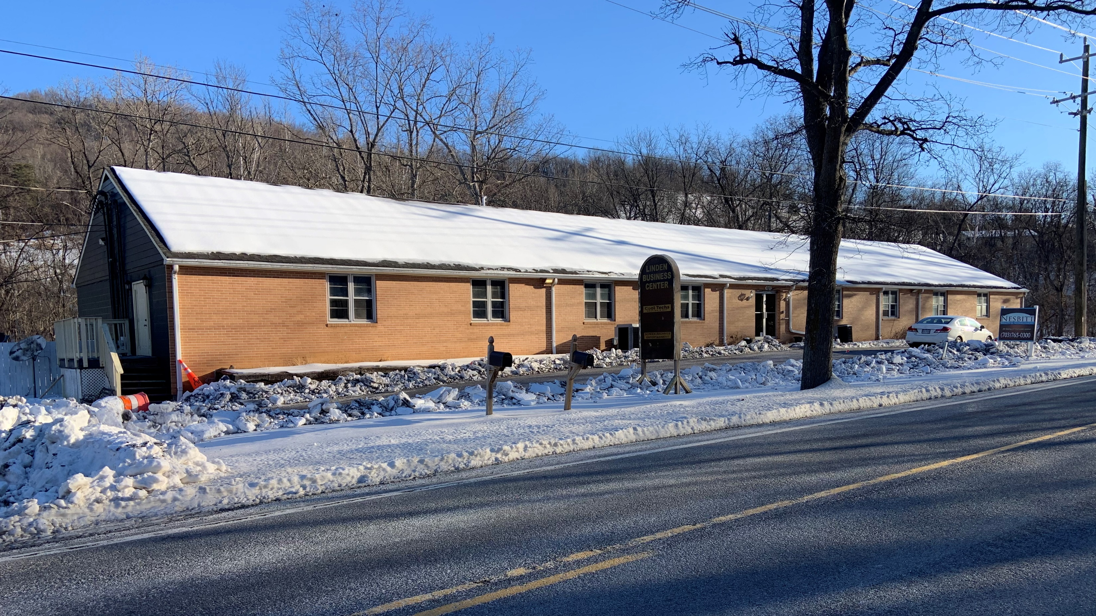
Our present Location
Where we are
Notes:
WHERE WE ARE: OUR PRESENT REALITY
Our current space is simply not sustainable for the future of our parish.
We are truly grateful for this building; it served us well in our early days.
However, we have outgrown it. Obviously, It was never designed for sacred use, and it cannot provide the long‑term stability we need for worship and parish life.

Slide 4
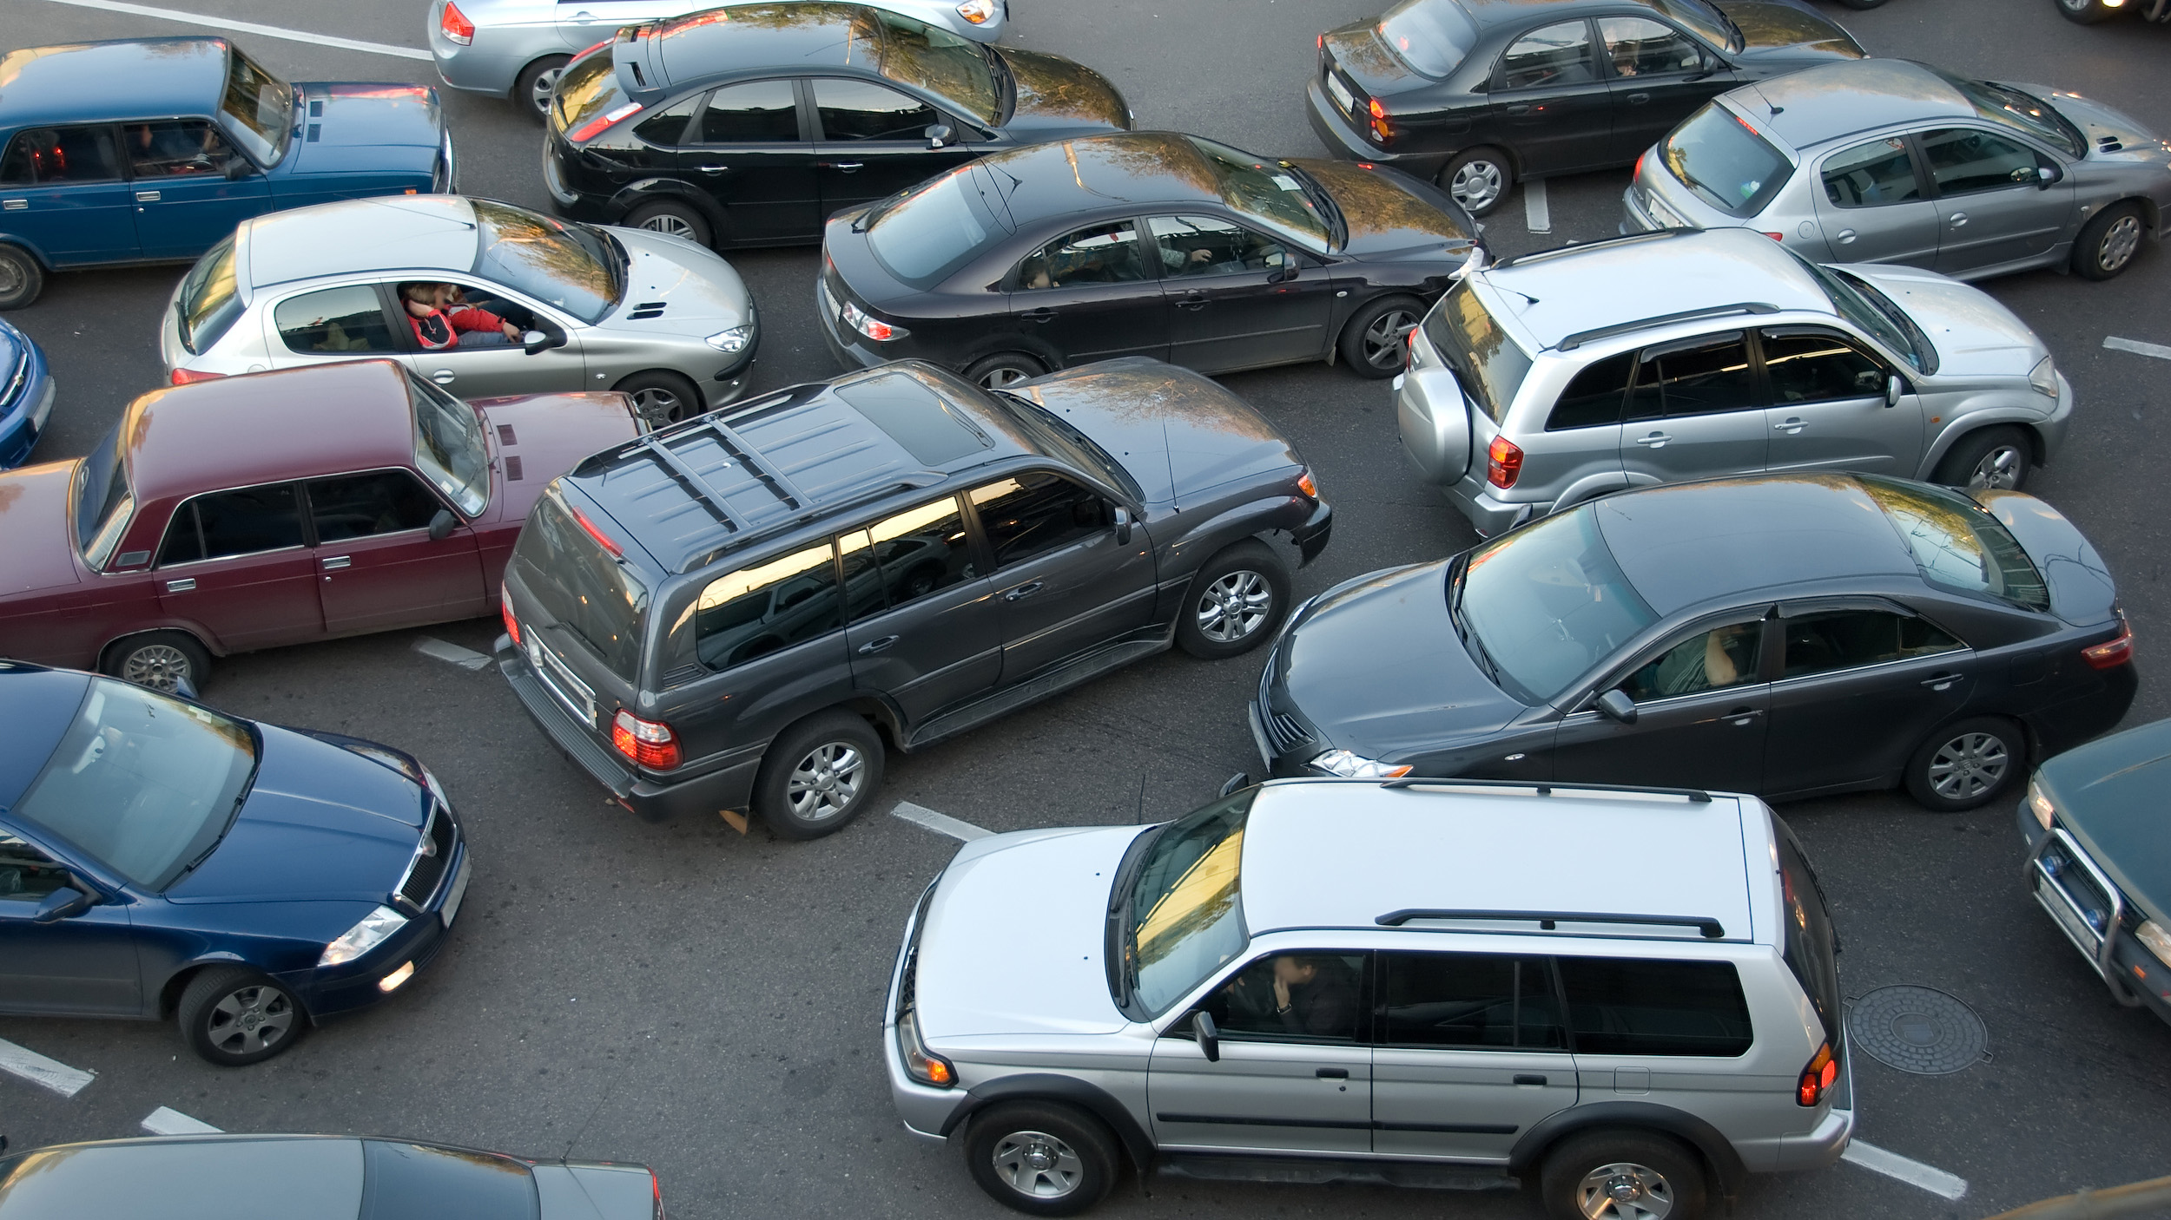
Present reality
A Leased Office is not Designed for Sacred Worship.
Offers No Long-Term stability.
Provides no protection amid growing uncertainties.
Attendance often Exceeds Capacity – Especially with Parking.
CCTV Overflow divides the faithful – Creating a loss of unity.
Leasing keeps the Apostolate vulnerable to landlord changes.
Limited access for families, elderly and disabled.
Safety & Accessibility Concerns; Traffic, Lack of Parking Spaces.
Lack of Capacity
PARKING LOT – No Empty Spaces
Notes:
The Reality is:
Attendance frequently exceeds capacity, forcing us into overflow areas. This separates the faithful, weakens our sense of unity, and diminishes reverence and sacramental focus.
In today’s ecclesial climate, stability is essential. A permanent chapel would provide continuity and security for future generations.
Our parking situation remains a significant challenge, affecting safety, accessibility, and the overall experience—especially for families and the elderly.

Slide 5
Why this project is necessary
Feature | Permanent Chapel | Leased Space
Mission | Fulfilling the Society’s Mission to “Restore all things in Christ” | Leased property subjects us to eviction and local ecclesial pressure applied to landlords.
Community | Fosters a “Center of Tradition” Formation of the Faithful | Rental Property hinders parish identity. Creates a “Temporary” Perception
Stability | Long-term Presence – Offering Continuity in Uncertain times. | Lease Termination - Risk of Relocation.
Architecture | Full Control over Design & Use. Beauty of God’s House - Inspires. | Limited by Building Design, Lease, and Landlord.
Long-Term Cost | Lower over Time – Investment in our Children | Higher over Time – Subject to rising Rent.
Financial | Builds Equity and Appreciation | Sinks Funds into Rent with no long-term benefit.
Notes:
Some of the many Reasons Why This Project is Necessary:
Mission – This chapel strengthens our ability to continue advancing God’s Kingdom through the Mass, sacraments, and formation of souls. -
Community – A permanent site creates the foundation for future growth, including the hope of one day establishing a priory.
Stability – A permanent home provides continuity and security for the faithful, especially in uncertain times. -
Architecture – A permanent chapel allows for a beautiful sanctuary designed with verticality—lifting hearts and minds to God and reflecting the beauty of divine worship.
Long-Term Cost – Rather than ongoing rent with no return, this project is an investment in the next generation and the future of our parish.
Financial – A comparison of a permanent chapel versus leased space shows the long-term benefit of ownership. We currently spend approximately $5,000 per month in rent, with limited landlord support, and must also cover additional maintenance costs that would normally be the responsibility of a landlord.

Slide 6
God’s Timing, God’s Plan What lies ahead
History: 2021: Raised funds to purchase a 10-acre lot; later sold due to unresolved land issues, recovering nearly the full investment. The experience underscored the critical importance of thorough feasibility studies and careful property due diligence for the chapel project.
Late 2023: Under Fr. Wiseman’s leadership, the St. Joseph Committee pursued purchasing and renovating an existing building; a long-preferred approach. However, after more than a year of searching, no viable options emerged. Fr. Wiseman then shifted our focus back to acquiring land and building a chapel.
Notes:
Understanding the importance of having a permanent chapel. We began our search in 2021, just under five years ago. After a brief fundraising effort, we purchased a 10-acre lot in early December 2021. However, due to several unresolved land issues discovered only after the purchase, it was decided to sell the property and take a new direction. Fortunately, we were eventually able to sell the land for approximately what we had paid for it.
Although the outcome was not what we had hoped for, the experience proved invaluable, showing us how essential it is to conduct a thorough feasibility study and exercise careful due diligence when selecting property for the chapel.
Building on that experience, and under Fr. Wiseman’s direction, the St. Joseph Committee began in late 2023 to focus on finding a property with an existing building that could be renovated for our needs. This has been the Society’s preferred approach for many years. However, after more than a year of searching and considering many possibilities, none proved suitable or prudent. Through prayer and careful discernment, Fr. Wiseman decided to redirect our efforts toward finding acreage again and building a chapel.

Slide 7
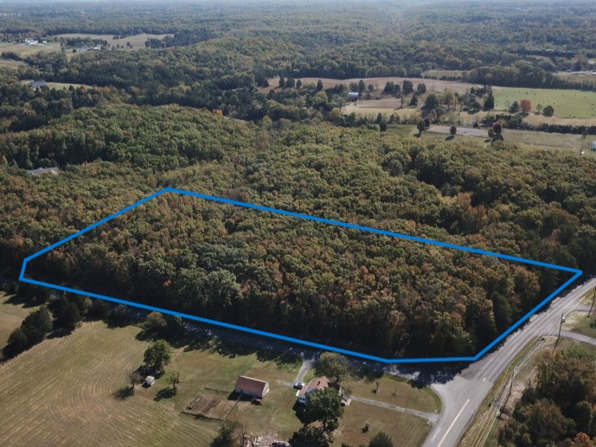
Land Search & Discovery:
ACREAGE - 9.38 ACRES
LOCATION - TAX MAP 91A83A
RELIANCE & HUTTLE ROAD
MIDDLETOWN, VA 22645
FREDERICK COUNTY, VA
PRICE - $349,000
ZONED RA – SECTION 165-401.02 (G) – CHURCHES ALLOWED BY-RIGHT.
Huttle Rd.
Reliance Rd.
Notes:
After months of reviewing numerous properties, in April 2025 Dr. David Forsythe—appointed by Fr. Wiseman to lead the search for suitable acreage—identified a 9.38-acre parcel off Reliance Road in Middletown, Virginia. (Frederick County)
The property was immediately evaluated using our established criteria, Which included: a minimum of 7 acres; location within a 20-mile radius from the center of Front Royal; zoning that permits a church; a purchase price under $500,000; and overall suitability for development, including favorable topography, access to utilities, minimal wetlands impact, and acceptable soil conditions.
After a positive preliminary review, we placed the property under contract with a 180-day feasibility contingency. This contingency period allowed us to confirm our initial findings directly with the county. After meeting with the Counties Technical Review Committee (TRC), conducting engineered soils testing, completing a boundary survey, and obtaining an official Zoning Determination from the County.
In October 2025, we closed on this property and began our pre-construction phase of this property.

Slide 8
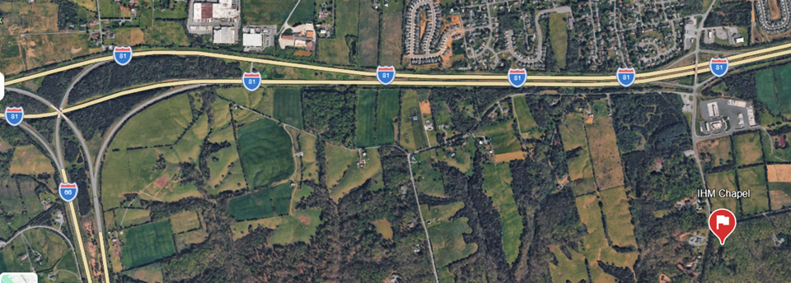
Location
I-81 Exit 302 VA-627; Middletown, VA
Notes:
Property is just off I-81 at Exit 302.
This would be the first exit after turning on to Northbound I-81 from I-66.

Slide 9
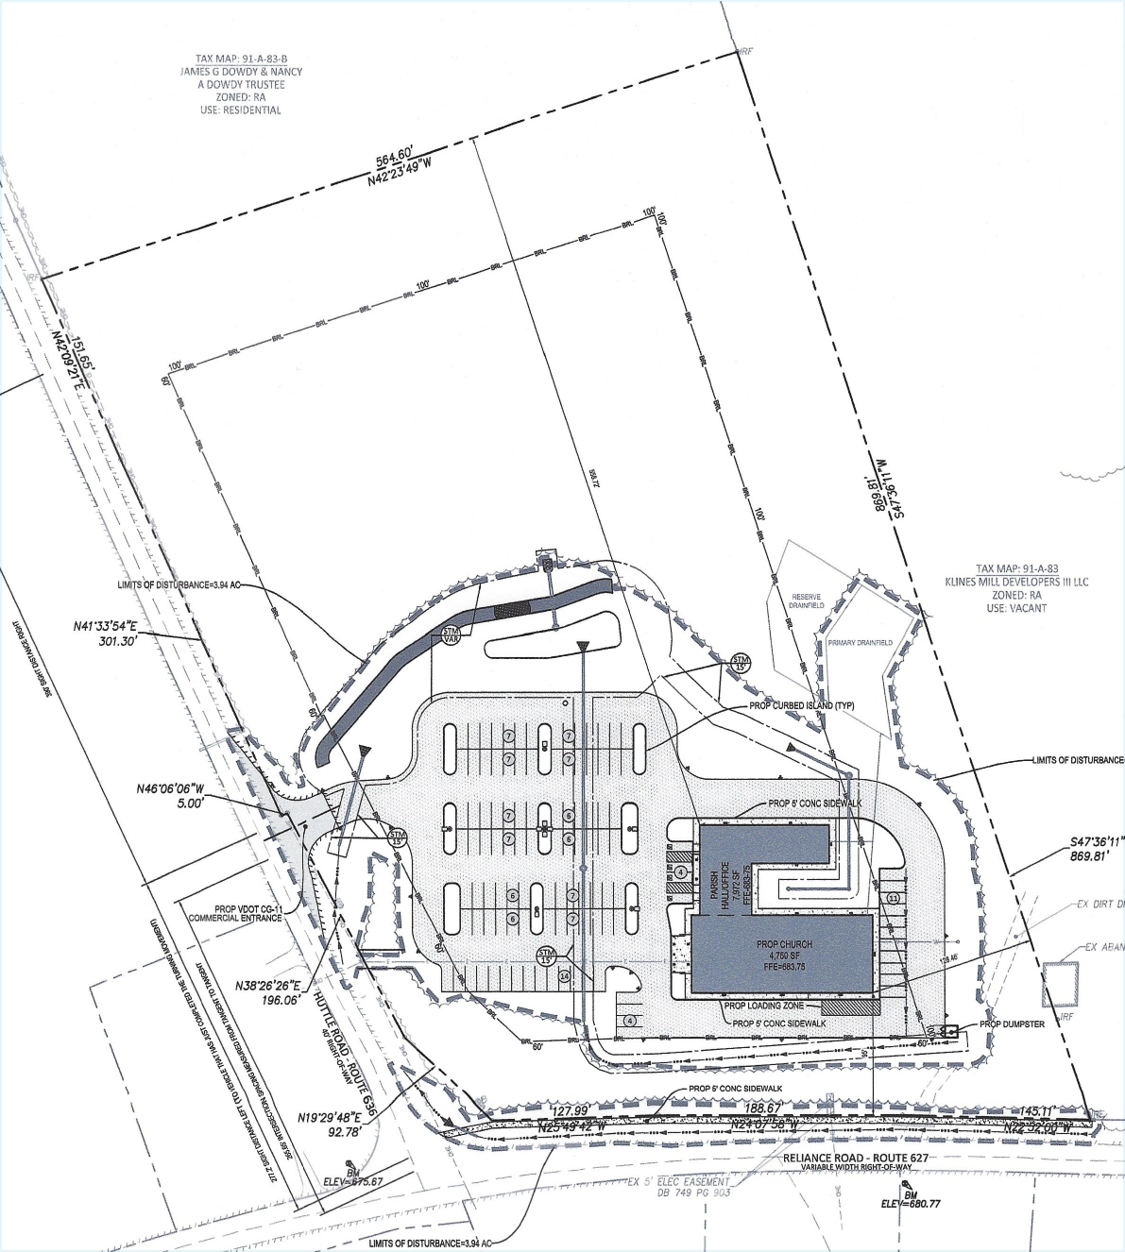
Property layout
N
Total property: 9.3 Acres
Building, Parking and Landscaping: 4 Acres
Dedicated Green space for future: 5.3 Acres
Stations of The Cross
Picnic spots
Playground
Notes:
Our Property Layout
Here you see our property line, outlining our 9.3 acres, and an interior line that marks the required setbacks: 100 feet from neighboring properties and 60 feet from any road.
We cannot build anything permanent inside this setback area. We can, however, use it for the drainfield, well, driveway, portable storage buildings, walking trails, and similar needs.
The remaining acreage could welcome future outdoor devotion and parish life: Stations of the Cross, picnics, playgrounds, and other gatherings.
Our hope is that one day, we may be able to acquire the adjacent property as well, which would be an ideal site for a beautiful chapel—Lord willing.

Slide 10
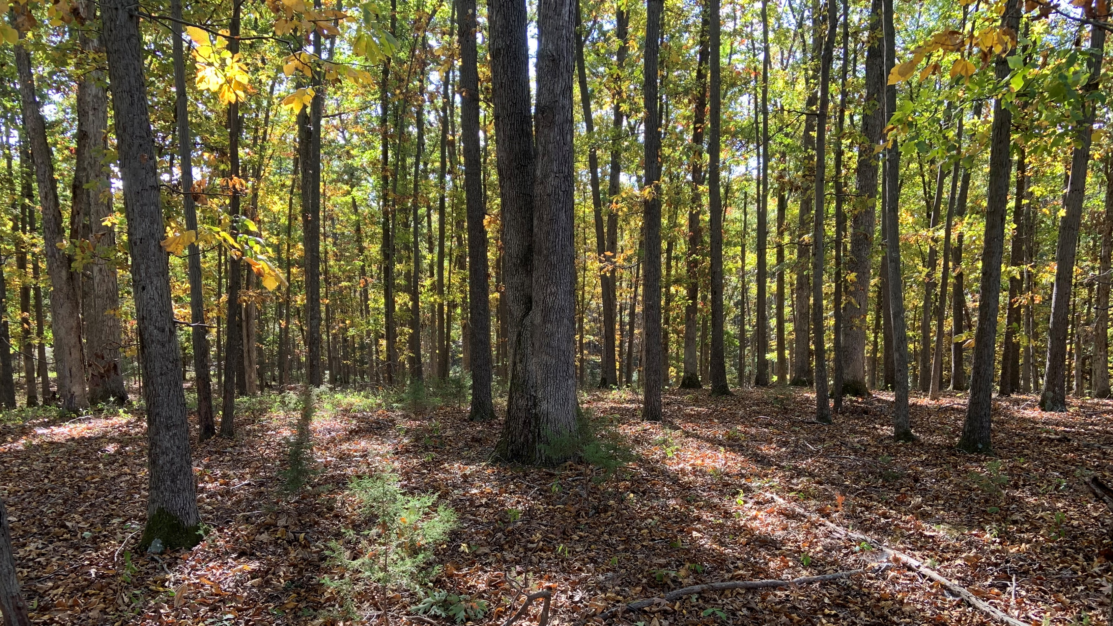
Views of the Property
Notes:
This is a picture on the property during the summer. I think you can appreciate why this would be ideal for a trail with the Stations.

Slide 11

Notes:
Another picture – Next Slide

Slide 12
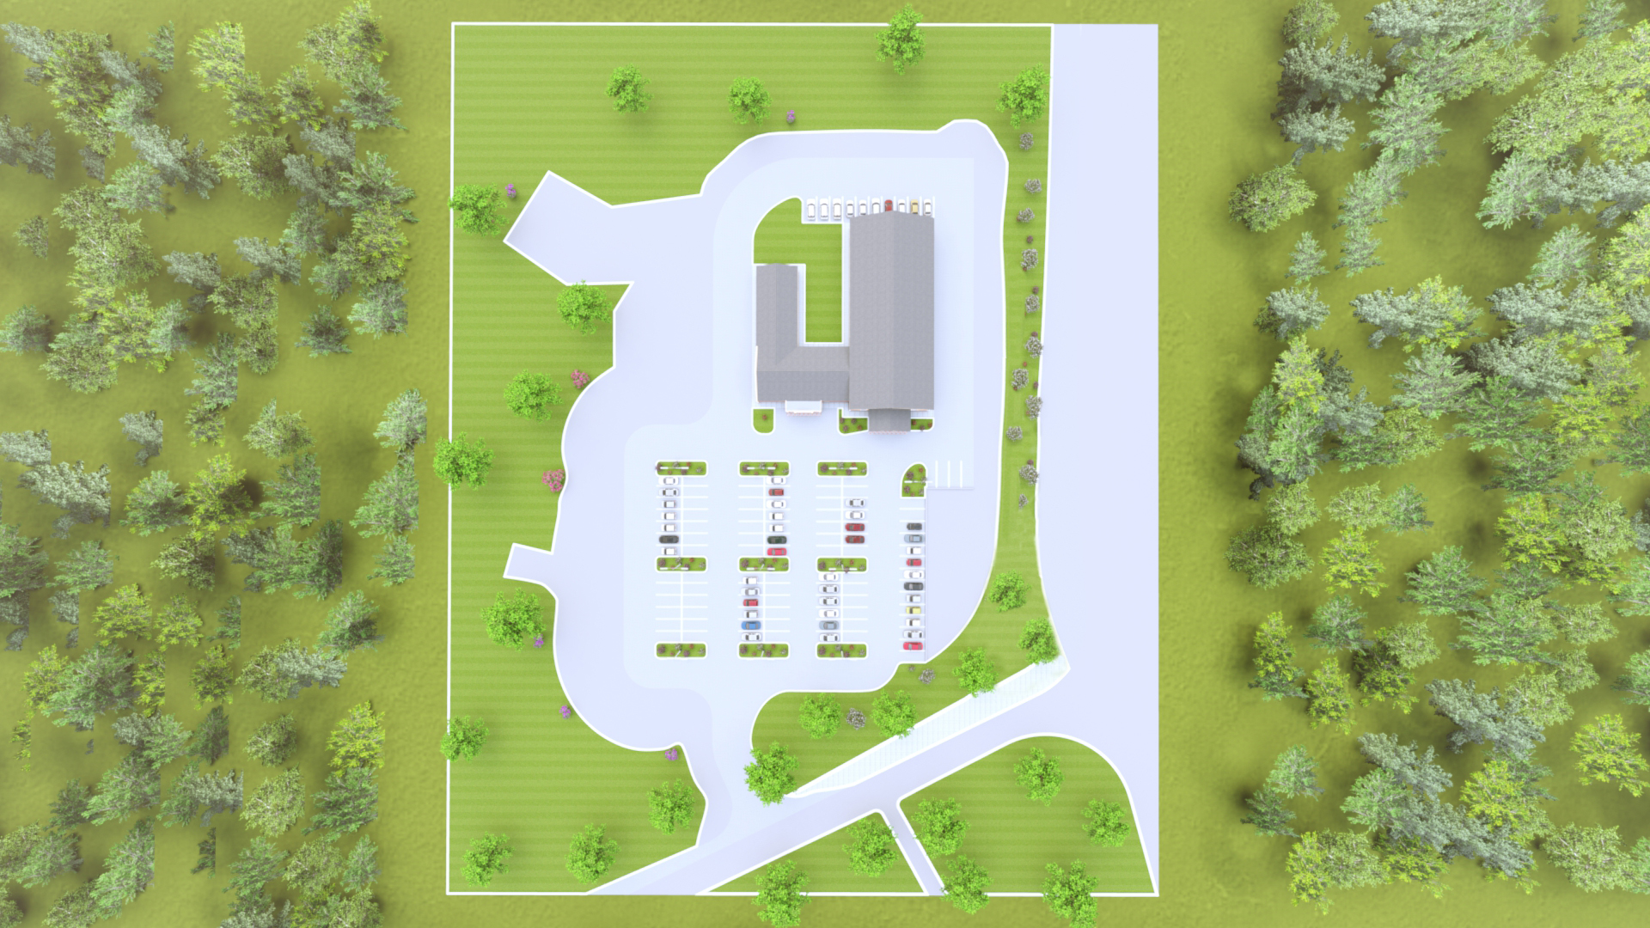
Van Parking
Courtyard
Handicap Parking
Reliance Road
Entrance
Huttle Road
Overview - Rendering
Notes:
This birds-eye view shows the property layout, including Reliance and Huttle Road. Please note that the entrance is only via Huttle Road, a very low-traffic street with excellent visibility in both directions.

Slide 13
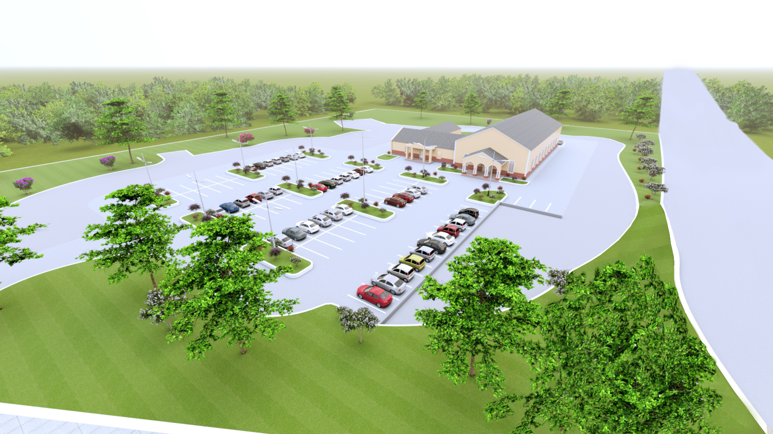
Notes:
Another Overview Rendering - Please remember that these pictures are renderings that are designed to give you perspective and a sense of scale rather than exact designs.

Slide 14
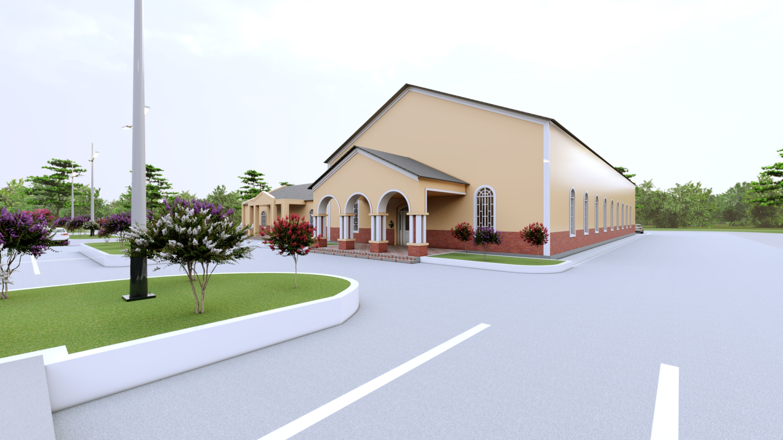
This project is not driven by ambition or extravagance. It is about providing what is truly necessary, realistic, and lasting for the worship of God and the care of souls.
Notes:
This is a conceptual rendering of the chapel. The actual buildings will be constructed of metal, so their final appearance will differ from what is shown here. The colors have not yet been selected, and the wainscoting will be chosen after the color palette is finalized. Our construction goal is Affordable Sustainability and to make the chapel as beautiful as possible within the budget God provides.

Slide 15
Notes:
Another perspective.

Slide 16
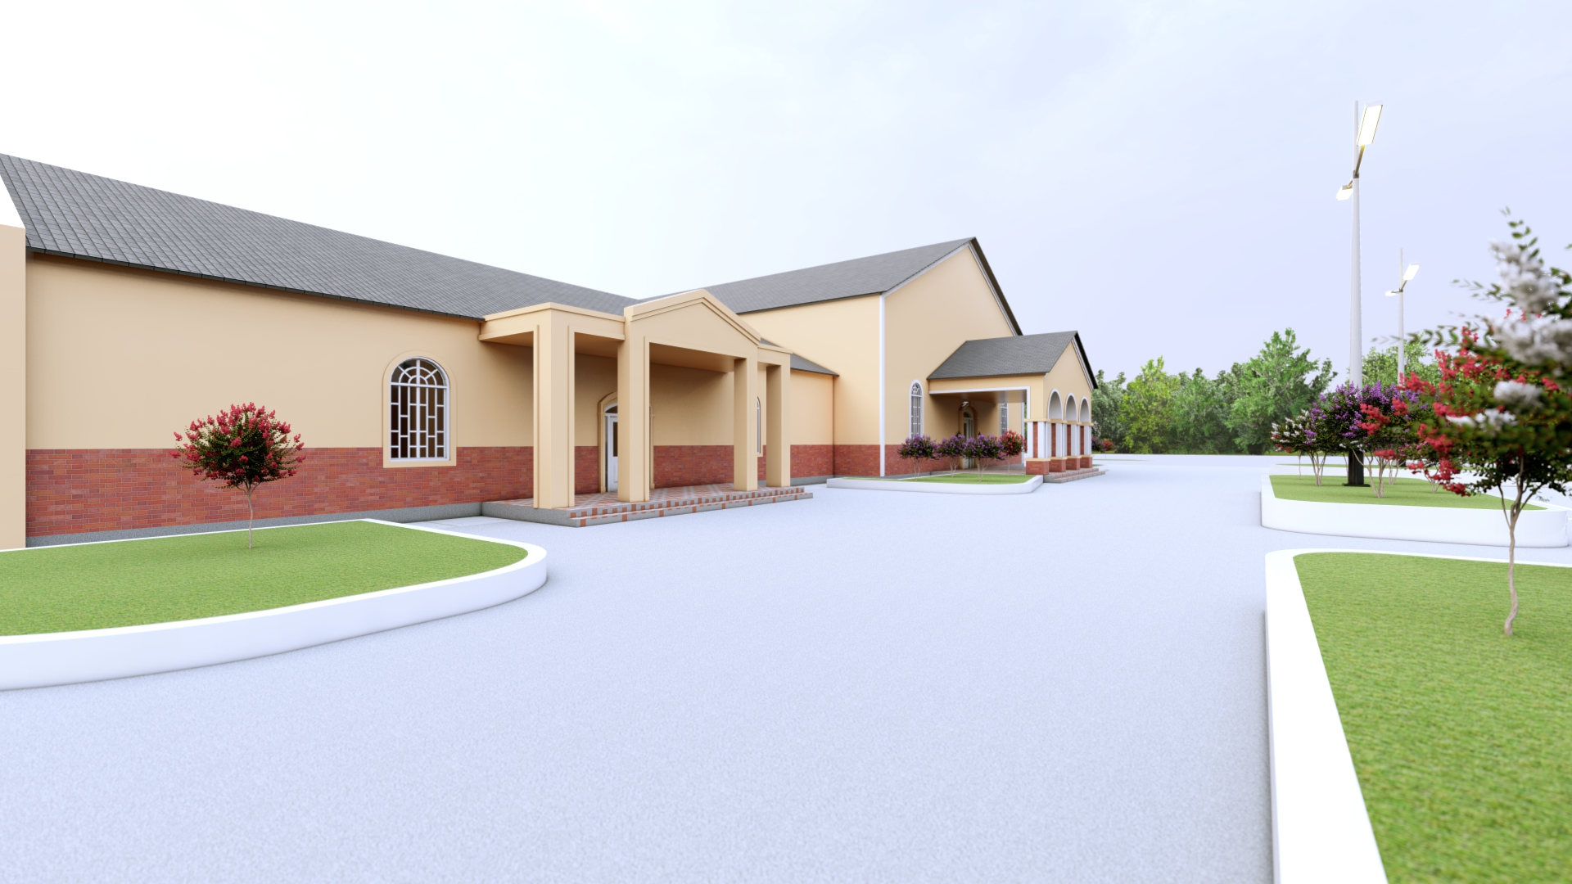
Notes:
The front of the Parish Hall has already been changed. We removed the little portico and turned this area into Handicap Parking.

Slide 17
Floor Plan
Chapel
Parish Hall
Admin. Wing
Notes:
This slide shows the full floor plan which consists of the Chapel, Parish Hall, and Admin wing. The admin wingwhich also has along with additional offices, classrooms, and a space designated for priest quarters.
This area will also include the restrooms and the kitchen, which will serve parish events and gatherings.
One unique feature of this design is that the additional wings are classified as a completely separate building. The two sections are divided by what is called a three-hour firewall. While this does add some cost to the project, it ultimately helps us avoid the significantly higher expenses and additional requirements that come with constructing a single building larger than 10,000 square feet. Capacity load trigger stricter safety requirements – Egress width, Corridor width, number of Restrooms, Increased Structural Design, Advanced Fire Safety Systems.
This design helps us to effectively manage our resources, especially if we find ourselves struggling financially near the end of this project. For example, if we need to cut cost, we may be able to postpone the finish work on the parish hall and acquire a Temporary Occupancy Certificate to use the chapel on Sundays, while we finish the work.

Slide 18
Chapel floor plan
Main Entrance
Notes:
A little closer look at the chapel floor plan.
Starting at the entrance you step into the Narthex, which helps us transition from the outside world into our Father’s House.
From the Nathex you enter the nave, which is the main seating area for the laity.
The Sanctuary with everything designed to lead one’s attention and focus to the Altar.
A Sacristy on each side of the Sanctuary. One for the Altar Boys and one for the Priest.
The plan is to create a storage area above the sacristies.

Slide 19
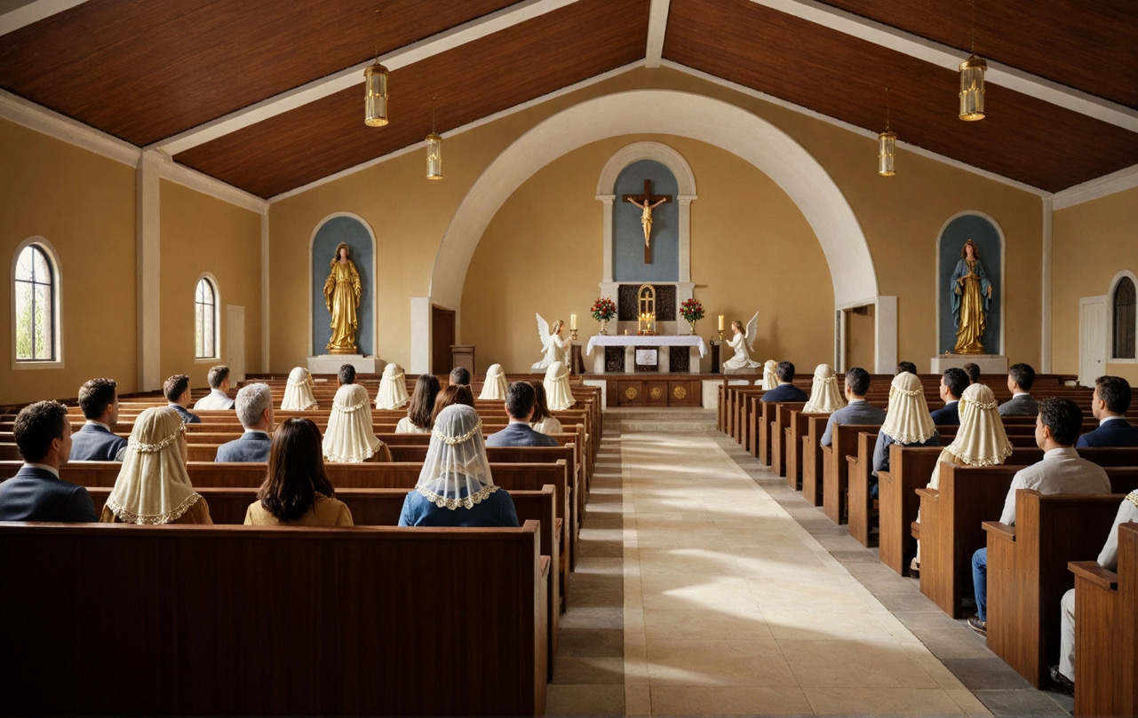
Notes:
Here is a conceptual Rendering of the inside, again just for perspective. Sacristy doors on both sides of the sanctuary – Focus is drawn to the Altar, especially with the arch between the sacristies and the special lighting designs that are planned.
Storage above the sacristies.

Slide 20
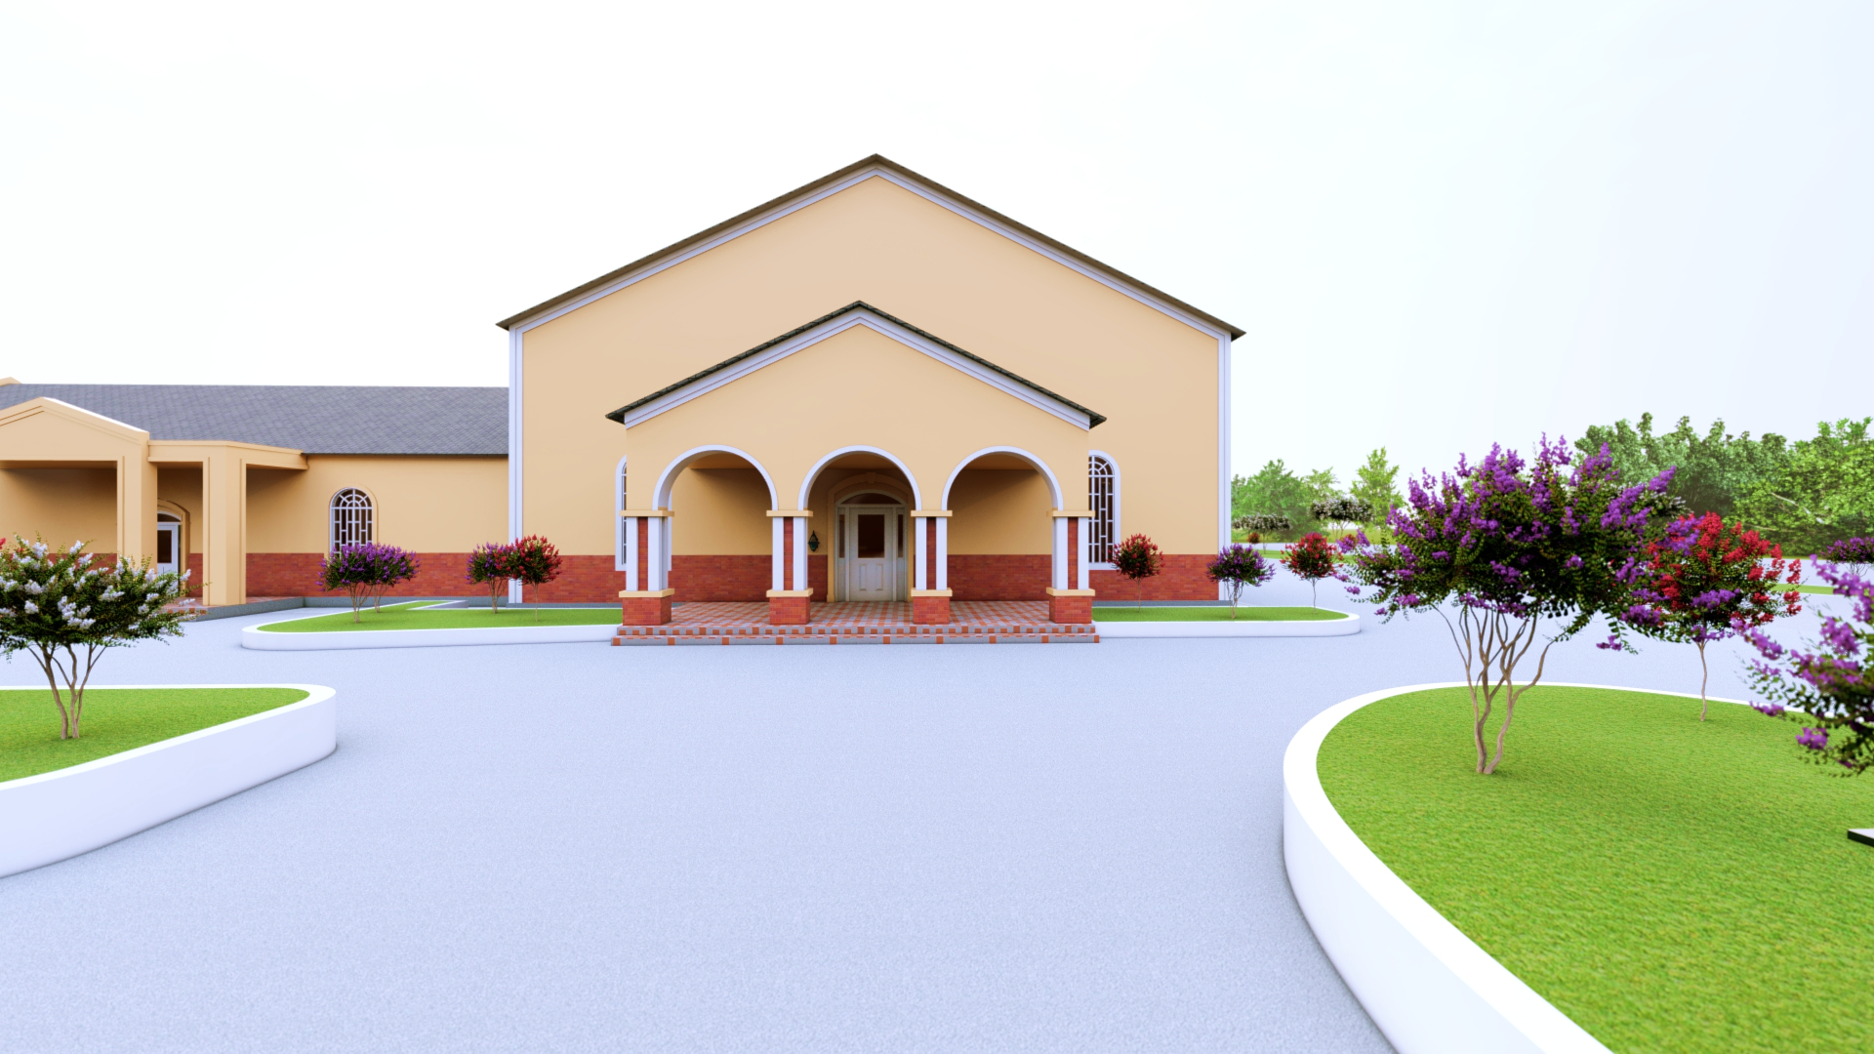
Cost of The vision before us
A Place of Worship to serve our families, our children, and future generations.
The Building Project
Construction Goal is Affordable Sustainability
Estimated Investment Needed: $3.2 Million
This is not just a building.
It is a home for Our Lord Jesus Christ, for prayer, for baptisms, weddings, and funerals; for the life of our parish.
Notes:
*Read First Bullet Point*
Building Project:
Our Construction Goal is Affordable Sustainability, and to make a chapel as beautiful as possible within the budget that God has provided.
Category - Percent - Costs
Pre-Construction - 9% - 288,000
Site & Utilities - 29% - 896,000
Building Construction - 34% - 1,120,000
FFE & Technology - 12% - 384,000
Post Construction - 8% - 256,000
Contingency & Miscellaneous - 8% - 256,000
TOTAL - 3,200,000.00

Slide 21

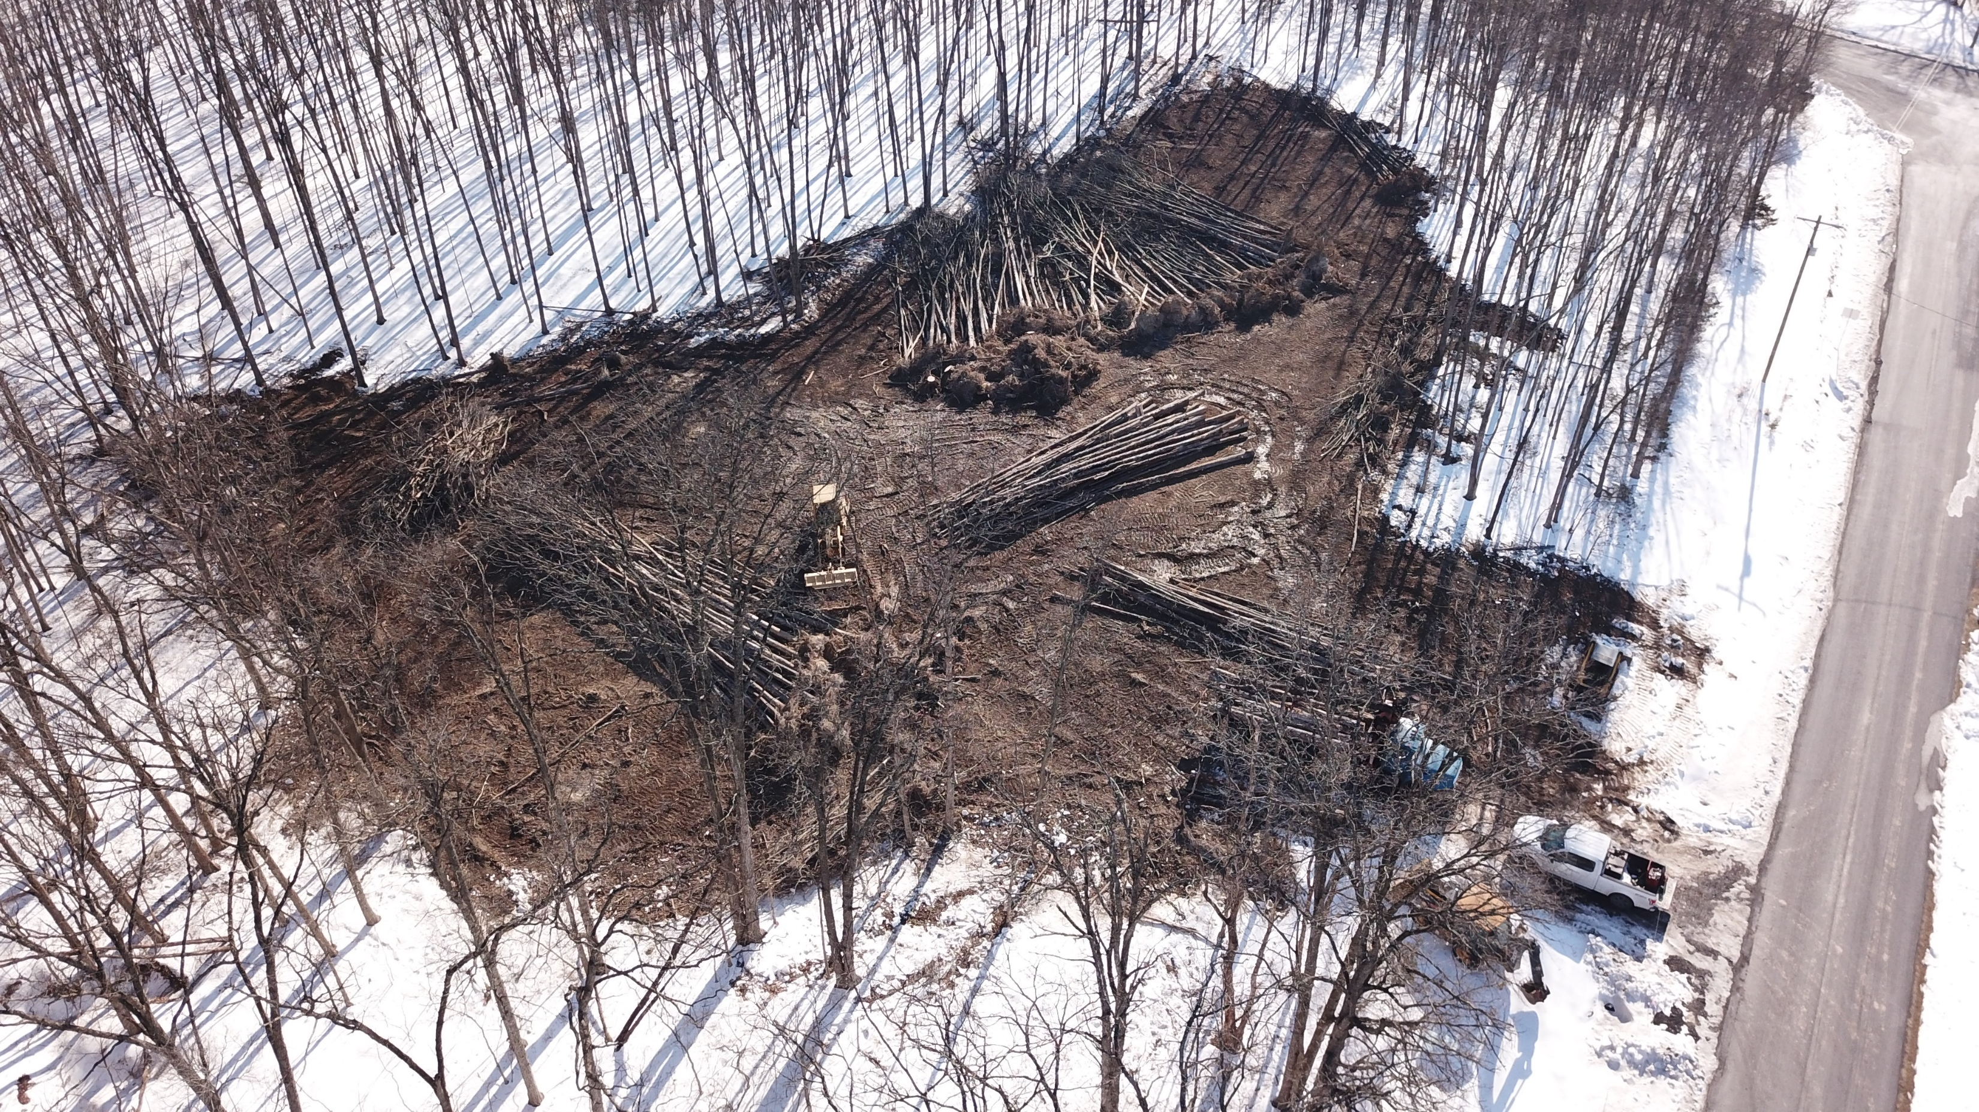
responsible & sustainable
approach
We Have Counted the Cost
Full project estimate (in progress).
Contingency included for cost overruns.
Conservative fundraising assumptions.
Phasing options available if needed.
Strategic Planning
Work in Progress
Notes:
We are still in the early stages of gathering bids and finalizing the design plans. As those details are completed, we’ll be able to share more precise cost estimates with you.
Like any construction project, we should expect some unforeseen expenses. At this time, we are estimating a contingency of about 8% of the total project cost.
Based on our past fundraising history, we recognize that our $1.8 million goal is ambitious for our chapel. Because of that, we will likely need to secure a modest loan from the District to complete the project.
With that possibility in mind, this is the reason that the building has been thoughtfully designed so it can be completed in phases, if necessary.
Strategic Planning to avoid regulatory delays and seasonal restrictions. – Proactive Scheduling prevents costly delays.

Slide 22
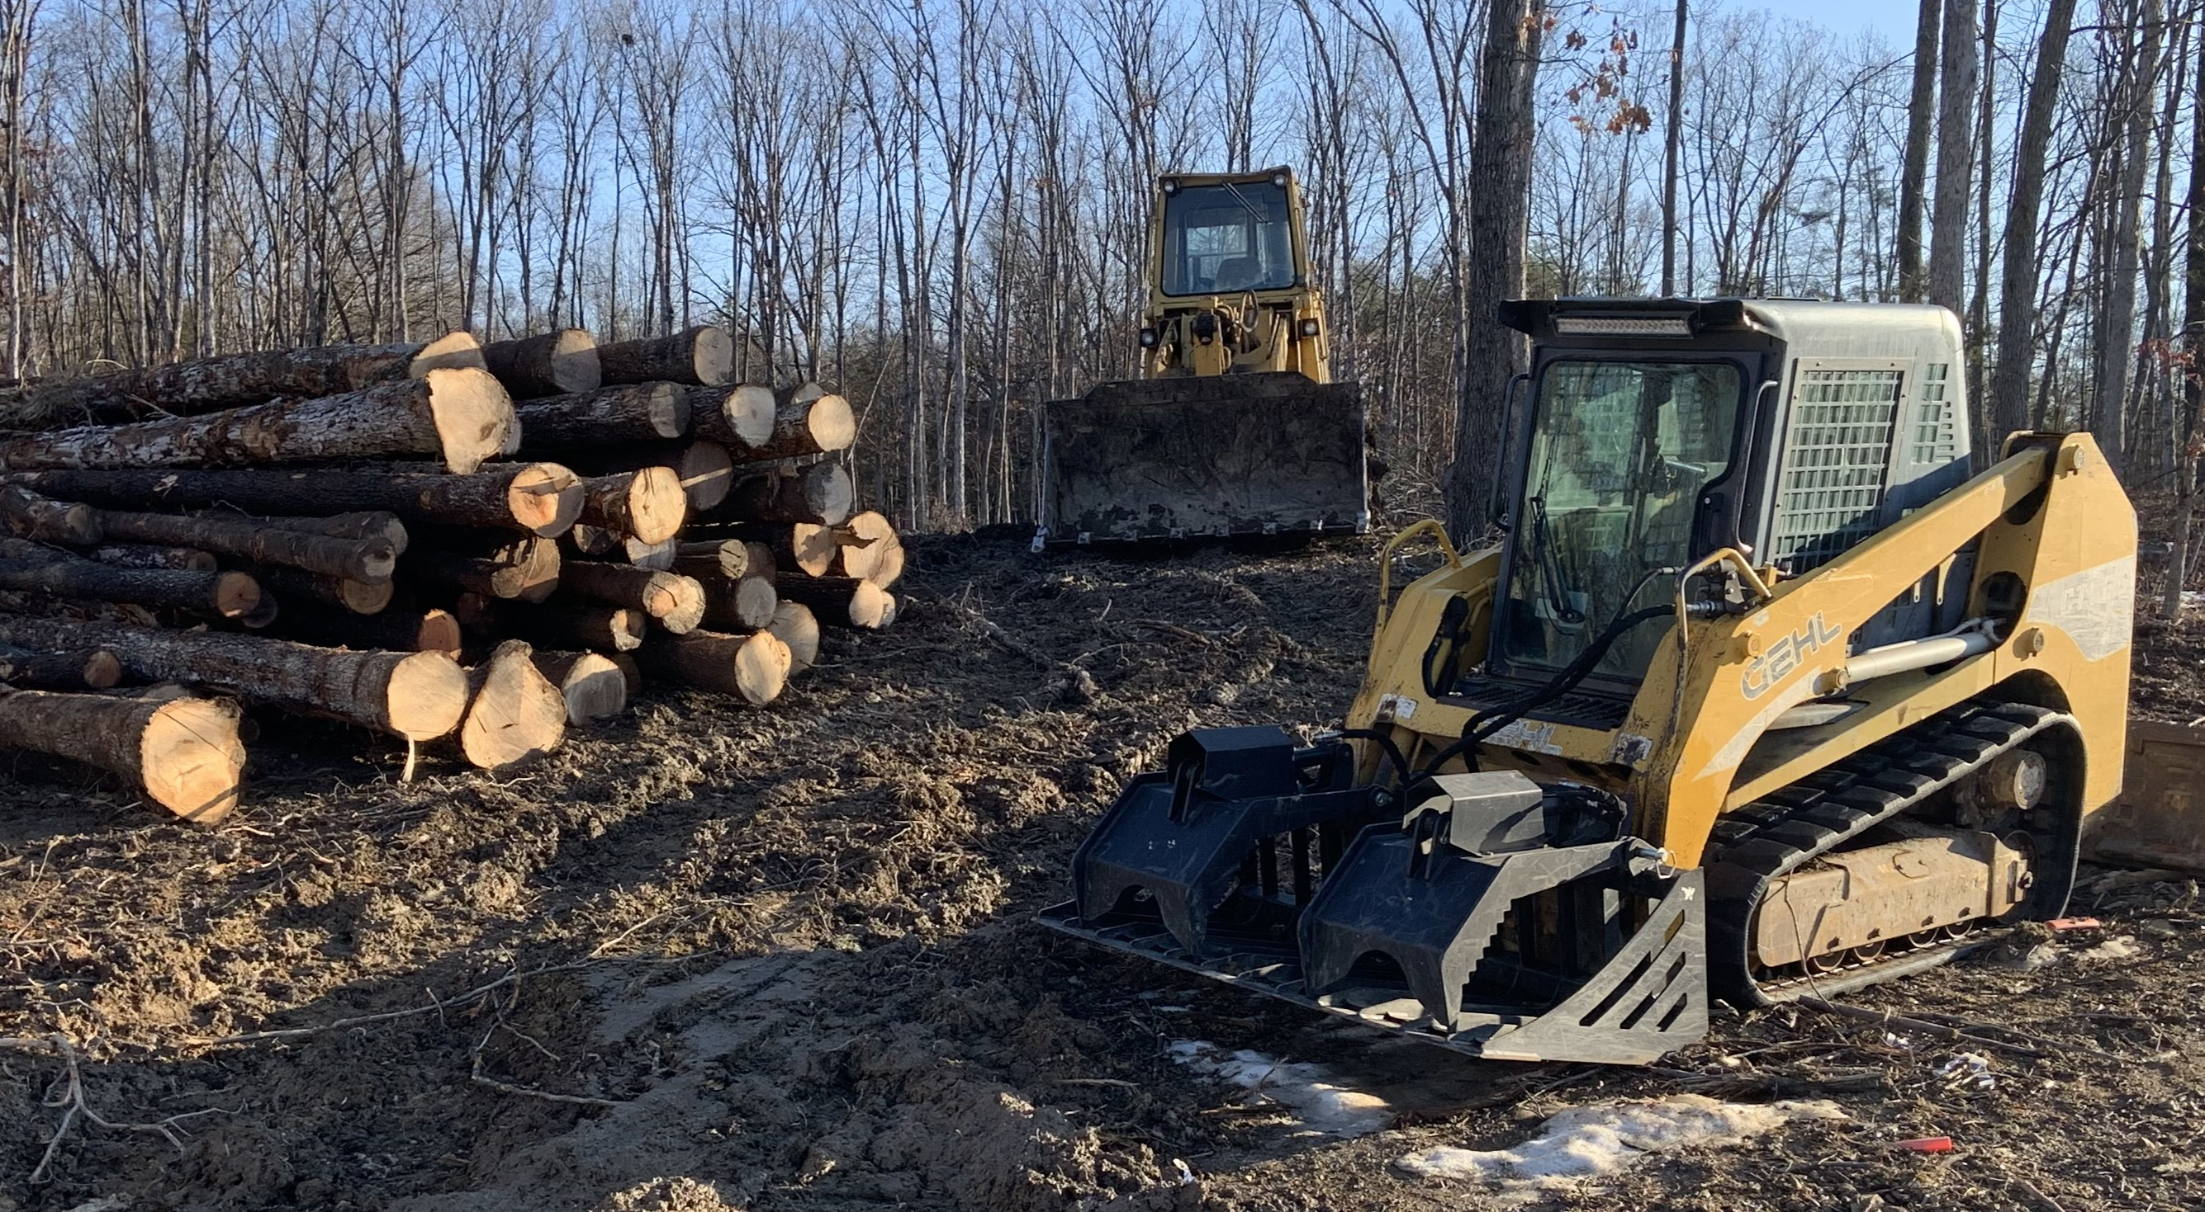
What God has already provided
Through generosity, sacrifice, and careful stewardship, our chapel already has $1.4 million set aside.
We are almost halfway there.
What Remains
$1.8 Million to Complete the Mission
This is the step of faith in front of us.
Site Work Has Begun
Notes:
Currently, we have $1.4 million set aside for this project. To date, approximately $50,000 has been invested in pre-construction work, including due diligence and early site preparation.

Slide 23
project schedule
Planning & Fundraising – 24 Months
Design & Permitting – 10 Months
Bidding & Building – 9 Months
Post Construction – 2 Months
The earliest possible date to be in the Chapel is June 2027
Notes:
The actual time of construction is very little compared to the administrative processes involved. For example, county approvals, permitting and inspections along with other administrative tasks can consume as much as 70% of the total project schedule. We also have an additional layer of administrative processes – The District.
If we were to break this down based on a two-year schedule:
Planning & Fundraising = 24 Months – This assumes that we acquire a loan to close and continue fundraising with pledges, etc.
Design & Permitting = 10 Months
Bidding & Building = 9 Months
Post Construction = 2 Months
So, much of this
Over the past month, we’ve successfully cleared the land by removing the trees. This puts us in a strong position to begin construction this summer, pending final approvals and permits. The timeline will largely depend on how smoothly and quickly that process moves forward.

Slide 24
from plans to providence
Our project plan outlines key milestones from design through construction.
With God’s help, the schedule is realistic but depends on your steady support.
Now we invite you to consider how you can participate financially in this work.
In the next few slides, we will outline:
Our funding needs and goals
Ways to give (one-time and ongoing)
How your support directly advances the chapel project
Together, we can build a fitting Chapel for the worship of Almighty God.

Slide 25
goals and funding needs
Complete our new chapel so that it will serve today as a beautiful house of God and, in time, as a space that can be adapted to support other parish needs.
Provide a reverent sanctuary, confessional, choir gallery, and devotional shrines that truly support the traditional liturgy and parish life.
Meet financial needs of $1.4M in the next 15 months so we can stay on schedule, avoid construction delays, and dedicate the chapel as planned.

Slide 26
methods of giving
Make a Direct Gift – Contribute a stated amount to the Building Fund.
Online Giving – Zeffy (Link via Website)
Bank Drafts (ACH transfers)
Pledges – Complete a Pledge Card (Coming Soon)
Donation of Appreciated Securities/Stocks (Avoid Capital Gains)
Donating via a Will/Estate Planning
In-Kind Contributions: Professional Services, Building Materials and volunteer labor that reduce costs while directly supporting the work.

Slide 27
how your support advances our mission
Every gift translates into visible progress: poured foundations, framed walls, installed pews, and completed sacred art and furnishings.
Your generosity strengthens parish life by supporting devotions, catechism classes, and providing a permanent and worthy setting for the Holy Mass and Sacraments.
By investing in this chapel, you share directly in the spiritual fruits offered here: conversions, vocations, and graces for families, now and long into the future.

Slide 28
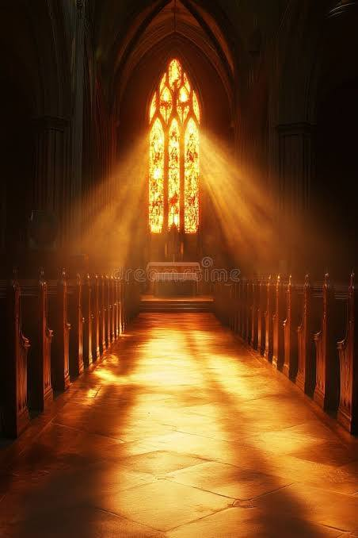
IHM BUILDING PROJECT
“Beauty is that which, upon being seen, pleases.” — St. Thomas Aquinas
A purpose‑built chapel is not an aesthetic luxury; it is a place where beauty, proportion, and clarity (Aquinas) meet divine presence (St. John of the Cross), so that the architecture quietly lifts hearts to God, teaches the faith, and prepares souls for the Eucharist.
“We understand that people are more important than projects, but the beauty of God’s house increases the glory of God and the edification of souls. Beauty inspires, and there is no question that there have been spiritual benefits with still more fruits to come.” — Fr. Goldade
Notes:
As Catholics we know that because the Mass is the most important act on earth, the environment should reflect that beauty.
Unfortunately, we cannot afford everything we might wish for, but we must offer the best we can.

Slide 29
Immaculate Heart of Mary Chapel
Help us Build a New Home
Notes:
Rendering of the inside, again just for perspective. Sacristy on both sides of the sanctuary – Focus is drawn to the Altar, especially with the arch between the sacristies.
Storage above the sacristies.

